Slide 1
Roles and Responsibilities in IT

Slide 2
Introduction
This presentation outlines the various roles within a typical organizational IT department.
Depending on the type of the organization, there can be many layers, or just a few.

Slide 3
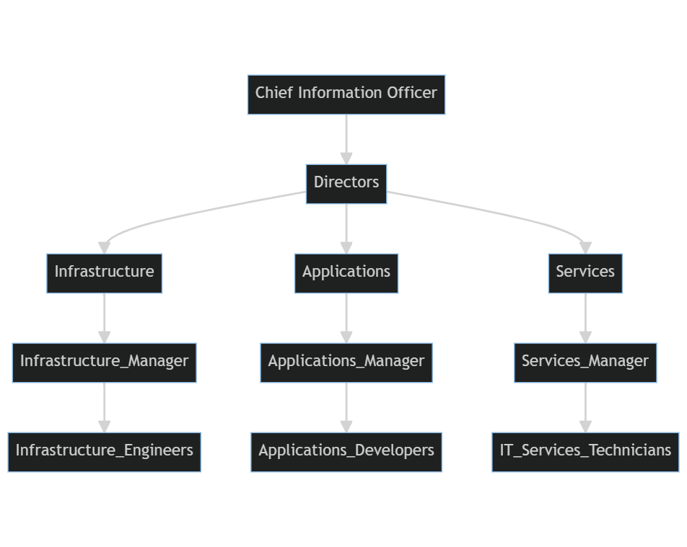
Typical IT Organizational Structure

Slide 4
Remarks
The size of the IT department and number of layers depends on the size of the company. But in general, IT maps to typical hierarchical business org structures.
Key responsibilities flow from strategy at the top to hands-on execution at the bottom. Shared services and centers of excellence improve quality and efficiency.
The structure allows IT to align to business needs from the top down, while also optimizing technology delivery.

Slide 5
Managerial Roles

Slide 6
CIO/CTO
The top executive responsible for the overall technology strategy and vision of the company
Reports to the CEO
Strategic leadership for IT vision and initiatives
Manages IT budget, staff, operations
Making high-level technology decisions on platforms, infrastructure, software, partnerships
Leading and motivating staff, promoting training and development
…

Slide 7
IT Directors
Manage teams and tactical execution for specific technologies and systems
Develop and implement IT strategies and initiatives aligned to business goals for their domain
Setting standards, policies, and governance practices for technology use and implementation
Managing budgets, costs, resources, and assets for the IT division under their purview.
Example: Head of Infrastructure

Slide 8
IT Managers
Manage teams and tactical execution for specific technologies and systems
Plan projects, set deadlines, assign tasks
Ensure service quality and systems uptime
Manage vendor relationships
Example: Head of banking application development

Slide 9
IT Governance Managers
Develop IT policies, controls, processes, and procedures to align with business objectives
Conducts audits and risk assessments to identify potential compliance issues and gaps in governance
Measures and reports on IT performance metrics to stakeholders on governance health.
Collaborates with IT leaders to implement governance practices through appropriate tools, education, and training
Stays current on IT governance best practices, regulations, and emerging technologies to evolve governance strategies
Example: Head of IT Governance / QA

Slide 10
Technical Roles - Development

Slide 11
Systems / Solutions Architects
Design and integrate complete end-to-end systems and solutions
Ensure optimal performance and scalability
Evaluate new infrastructure technologies
Maintain technical standards and governance
Example: Architect robust IT services for bank branches

Slide 12
Software Architects
Design architecture for software systems and applications
Ensure code quality, system robustness and security
Define coding standards and best practices
Prototype new solutions and upgrades
Example: Lead core banking software overhaul

Slide 13
Software Developers
Design, code, test, debug software applications
Collaborate with product managers on requirements
Write clean, maintainable, well-documented code
Example: Develop mobile banking apps

Slide 14
Software Testers
Perform functional, integration, system testing
Identify defects, inconsistencies, vulnerabilities
Document and track bugs through resolution
Big overlap with developers
Example: Test new core banking platform thoroughly before launch

Slide 15
Quality Assurance (QA) Testers
Develop and execute test plans, test cases, scripts
Conduct regression testing after changes
Report and validate fixes for bugs
Ensure software meets requirements
Example: QA Tester of Investment App

Slide 16
Technical Roles - Data

Slide 17
Data Architects
Design optimal data storage, integration, governance
Specify data models, schemas, metadata
Enforce data policies and access controls
Explore uses for AI/ML on bank data
Example: Introduce Big Data solutions

Slide 18
Data Engineers
Designs and implements database systems to support software applications
Develops schemas, tables, queries, and other database objects based on requirements
Performs capacity planning and scaling to ensure optimal database performance
Develops scripts, procedures, triggers, and functions to integrate with applications
Example: Develop Big Data storage

Slide 19
Technical Roles - Operations

Slide 20
Database Administrators
Install, configure, maintain databases
Monitor performance, troubleshoot issues
Perform upgrades, migrations, backups
Grant user access and manage permissions
Example: Manage customer databases

Slide 21
Network Administrators
Set up, administer wired/wireless networks
Provide access to authorized users
Monitor traffic, troubleshoot connectivity
Maintain VPNs, firewalls, routers
Example: Support bank branch connectivity

Slide 22
DevOps Engineers
Implement continuous integration and delivery
Automate and monitor builds, tests, releases
Configure infrastructure, pipelines, tools
Support collaboration between teams
Example: Oversee CI/CD pipelines

Slide 23
Cloud Engineers
Design, implement cloud infrastructure and services
Migrate systems and data to the cloud
Configure tools for provisioning, monitoring, management
Big overlap with DevOps nowadays
Example: Move bank systems to the cloud

Slide 24
IT Support / Help Desk
Troubleshoot problems reported by users
Diagnose hardware/software issues
Resolve account access, password reset issues
Guide users through solutions
Example: Assist bank employees with tech issues

Slide 25
Technical Roles - Security

Slide 26
Security Architects
Design and develops security architectures, policies, controls
Performs threat modeling and risk assessments to identify vulnerabilities in systems and applications
Recommends security solutions and advises on integrating security into networks, infrastructure, and software systems
Collaborates with stakeholders like engineers, executives, and end users to balance security with usability and other needs.
Keeps updated on cyber threats, attack vectors, and new regulatory and compliance requirements related to security.
Example: Implement new security measures after a hack

Slide 27
Information Security Analysts
Monitor systems for security threats and incidents
Perform security assessments, audits, risk analysis
Investigate breaches, document response plans
Example: Handle cyber attacks on the bank

Slide 28
Hybrid Roles

Slide 29
Project Managers
Oversee major IT projects end-to-end
Create project charter, plan scope, timeline, budget
Assemble team, assign responsibilities
Manage risks and issues, oversee communications
Track progress, prepare status reports
Example: Oversee core banking platform upgrade

Slide 30
Product Owners
Represent business/user needs in Agile development
Maintain and communicate product vision and roadmap
Prioritize features and user stories
Accept or reject work results
Example: Owner of an investment app

Slide 31
Scrum Masters
Facilitate Agile development processes and Scrum ceremonies
Coach team in Scrum principles and self-organization
Remove impediments, foster collaboration
Ensure transparency into team's progress

Slide 32
Business Analysts
Work with stakeholders to gather requirements
Document processes, analyze needs, identify solutions
Manage change requests, get sign-offs on designs
Example: Help bank improve loan application process

Slide 33
Exercise

Slide 34
IT Personnel Planning
In the scenarios below, your task is to find out how many, and which type of IT personnel are required to complete the given projects.
Scenario 1: A bank has 2 separate mobile apps for investments and account management that they want to consolidate into a single app.
Scenario 2: A startup is launching an IoT consumer product involving hardware, firmware, and a mobile app.
Scenario 3: A company wants to implement an AI chatbot on their website to handle customer support.

Slide 35
Thank you!
Q & A

